Slide 1
Embedded Systems
Communication

Slide 2
Learning objectives
Arduino communication
Serial communication
Introduction to protocols

Slide 3
Communication Protocol

Slide 4
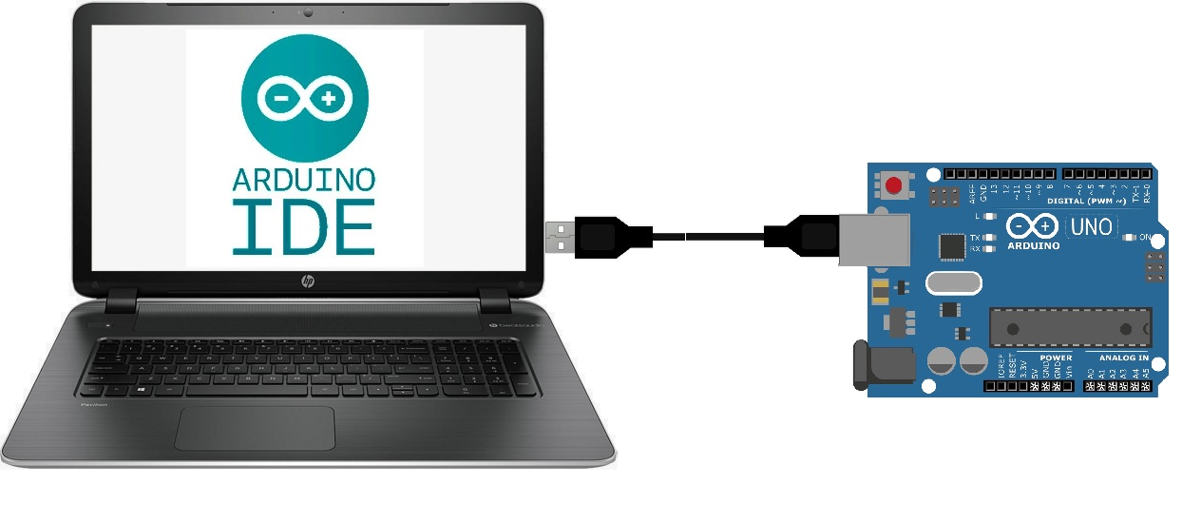
Serial communication
Communicate with host computer and back!

Slide 5
Communication
Communicating with other devices greatly improves utility.
Think about IOT devices:
Controlling your thermostat from your phone.
Analysing solar panel output efficiency
etc…

Slide 6
How to communicate
Both machines must understand each other.
Who starts first?
What messages are supported?
What do the messages look like?
This we call protocol.

Slide 7
Protocol Design
Simple commands:
start
stop
led1on
led2on
Drawbacks:
Limited to simple commands.
No parameters.
Leads to complex code.
Use it for toy applications

Slide 8
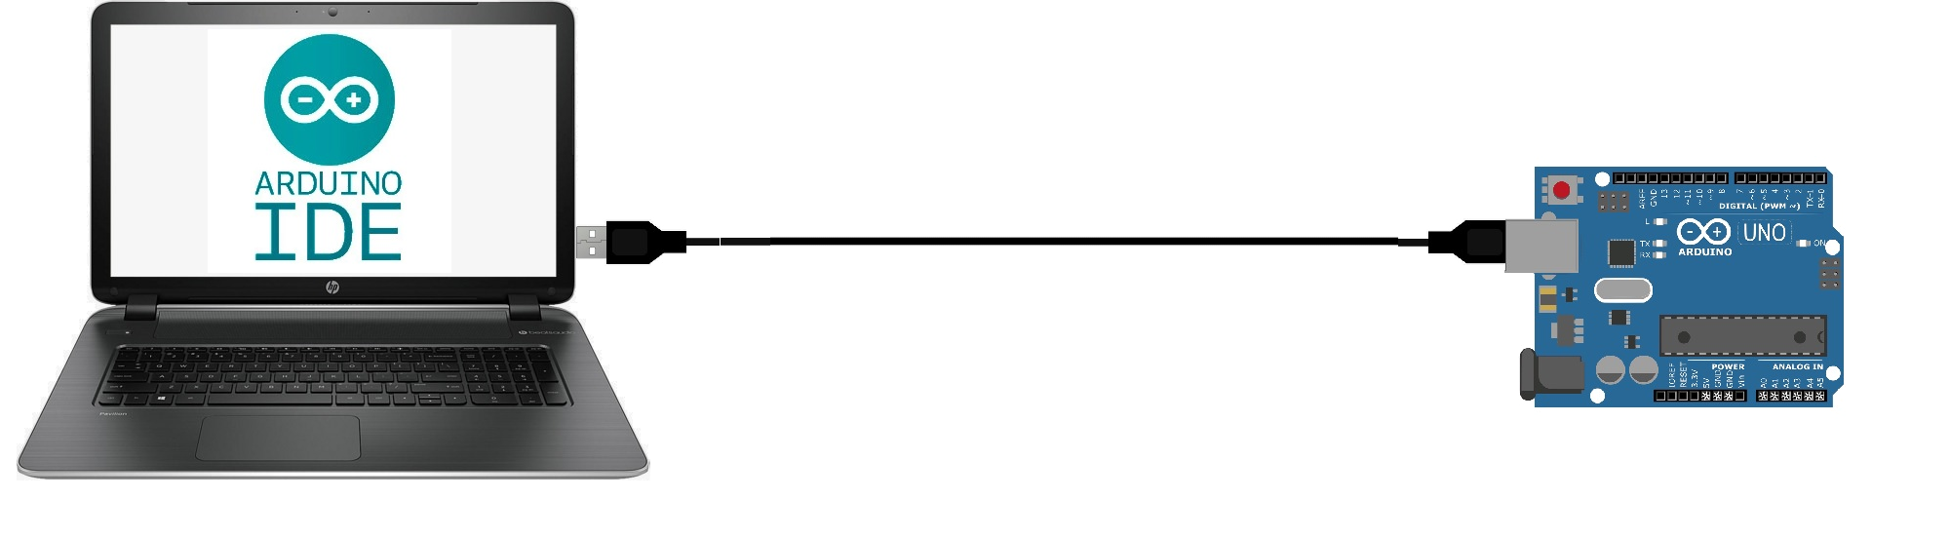
serialPort1.print(“start”);
serialPort1.print(“stop”);
serialPort1.print(“led1on”);
serialPort1.print(“led2on”);
The data is sent serially. So how to tell where a message begins and ends?
startstopled1onled2on

Slide 9
Design considerations
Message format:
Fixed length messages
Start-stop character
Advantages / Disadvantages
We’ll choose start-stop character
For now stop character is enough.
Notes:
Give examples of each of the requirements

Slide 10
Advantages/Disadvantages
Start/Stop character
+ Efficient in size
- More complicated code
Fixed length
+ Simpler code
- Limited size per message vs sending useless data
- possibly send multiple messages

Slide 11
Start/stop character
We can send small messages by sending with println.
The “newline” is the stop character.
Prepare the message string and send everything at once!
Example:
Serial.println(“BTN1UP”);
data that is sent is:
B,T,N,1,U,P,\r,\n

Slide 12
Example
Arduino:
string s;
int light = analogRead(LDR); //172
if (light > 500)
s = “LIGHT”
else
s = “DARK”
Serial.println(s);
You send:
L I G H T \r \n
Windows
you receive:
LIGHT
if (serialPort1.BytesToRead > 0)
{
string s = serialPort1.ReadLine();
s = s.Trim(); // Strip off the ‘\r’
}
result: LIGHT

Slide 13
Reading commands on a PC
Application in C#
Read data using the SerialPort component.
RS232 is a standard defining serial communication
Note: In windows, serial ports are named:
COM1, COM2, COM3, etc…

Slide 14
SerialPort (RS232) Key properties
Port (COM1, COM2)
Baud rate
Data length, Parity, Stop bits
Send / Receive
= the identifier in windows
= the modulation rate ~= kbps
= Data size, error checking
= Transmission commands

Slide 15
Arduino defaults
The Arduino defaults are:
Port: COM3
Baud rate: 9600
Word size: 8
Parity: None
Stop bits: 1

Slide 16
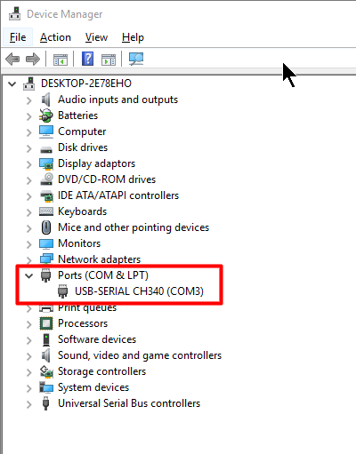
COM port on windows
Check which COM port has been assigned:
Click “Start”
Type: “Device Manager”
Check under Ports

Slide 17
From Arduino to Windows
Demo Application
Receive data from the Arduino

Slide 18
Arduino side
void setup()
{
Serial.begin(9600); // Baud rate
}
void loop()
{
Serial.println("Johnny five is alive!");
delay(1000); // wait 1 second and print again.
}

Slide 19
C# Steps
Create a new Windows Forms App
From the Toolbox → Components add the SerialPort to the form.
Check the default settings and make sure they’re the same as the Arduino defaults.
Set the PortName property to the correct COM port
In the FormLoad event, open the port: serialPort1.Open();

Slide 20
Reading input
Add a listbox and a button to the form
Give the listbox and the button a good name. E.g. lbxOutput and btnReadSerial
Double click the button to write code which responds to the Click event.

Slide 21
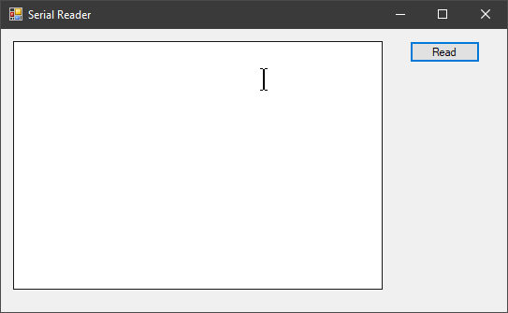

Slide 22
Code example
private void Form1_Load(object sender, EventArgs e)
{
serialPort1.Open();
}
private void Form1_FormClosed(object sender, FormClosedEventArgs e)
{
serialPort1.Close();
}

Slide 23
private void btnReadSerial_Click(object sender, EventArgs e)
{
if (serialPort1.BytesToRead > 0)
{
string line = serialPort1.ReadLine();
listBox1.Items.Add(line);
}
}

Slide 24
From windows to Arduino
Remote controlled program demo

Slide 25
Sample program
const int REDLED = 4;
void setup()
{
Serial.begin(9600);
pinMode(REDLED, OUTPUT);
}

Slide 26
void loop()
{
String line;
line = Serial.readStringUntil('\n');
if (line == "led1on")
digitalWrite(REDLED, HIGH);
if (line == "led1off")
digitalWrite(REDLED, LOW);
}

Slide 27
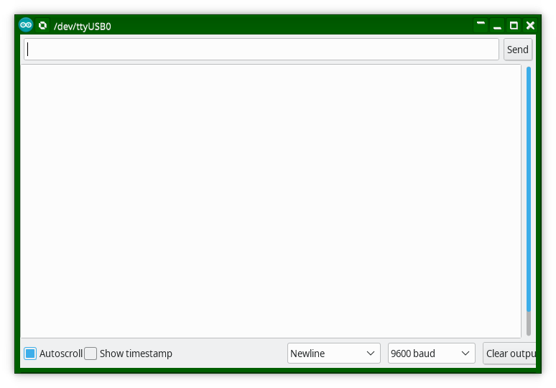
Protocol Design
Simple commands:
“led1on”,
“led1off”,
First we’ll enter these commands in the serial monitor.

Slide 28
Sending commands from a Windows app

Slide 29
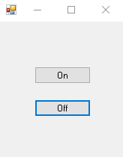
Windows application
Combine both examples and to control the LED from the form.

Slide 30
private void btnLedOn_Click(object sender, EventArgs e)
{
serialPort1.WriteLine("led1on");
}
private void btnLedOff_Click(object sender, EventArgs e)
{
serialPort1.WriteLine("led1off");
}
private void Form1_Load(object sender, EventArgs e)
{
serialPort1.Open();
}
private void Form1_FormClosed(object sender, FormClosedEventArgs e)
{
serialPort1.Close();
}

Slide 31
Loops continued

Slide 32
Review: while loop
while (/* condition */)
{
// action statements (body)
}
// continues here when condition is false
Repeats the action between the curly braces for as long as condition is true.
The condition MUST evaluate to (= result in) true / false

Slide 33
Repetition – do-while loop
The do-while loop works in the same way as the while loop, except that it always runs once even if the condition evaluates to false.
do
{
// action statements (body)
} while (/* condition */);
// continues here when condition is false

Slide 34
Repetition – for loop
Repeat in a more compact version than the while loop, the for loop.
for (int i=0; i < 100; i++) {
digitalWrite(LED1, HIGH);
delay(200);
digitalWrite(LED1, LOW);
delay(200);
}
Loop for i is between 0 and 100
Code to repeat

Slide 35
Repetition – for vs while
int i = 0;
while (i < 10)
{
// body
i = i + 1;
}
for (int i = 0; i< 10; i++) {
// body
}
The for loop is a compact version of the while loop.

Slide 36
Repetition – for loop
for (/* init */; /* condition */; /* action */)
{
// action statements (code body)
}
// continues here when condition is false
The for loop is a compact version of the while loop.

Slide 37
Repetition
4 kinds of loops
Arduino (execution framework)
void loop() {…}
C-language
while loop
do-while loop
for loop

